Slide 1
Working with sequence data: RNN and LSTM
Sequence data: Text and Time Series
Naïve approach: Use tfidf/count vectors
Embedding layers and word vectors
Using pre-trained word vectors
RNN
LSTM

Slide 2
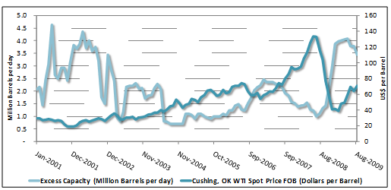
Working with sequence data: What is sequence data?
When, successive observations in data are dependent on each other
For example, when we deal with text data and time series data, accounting for sequential dependence becomes important
The cat ate a rat
The rat ate a cat
Context changes
We will focus on text data in this module

Slide 3
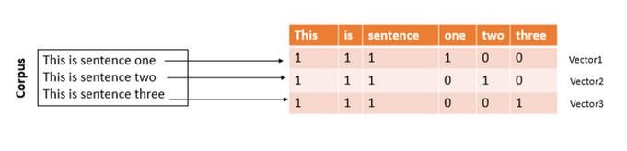
Working with sequence data, text
So, far, we’ve been using count matrix or tfidf matrix to represent text
The downside to using count matrix or tfidf matrix is:
The matrix is usually high dimensional
The matrix is usually sparse
The order of the text is ignored (context/meaning)
Having said that, tfidf and count matrix are still a very popular and useful ways of representing text
Let’s take a look at an example of text classification using Neural Networks and tfidf vectors

Slide 4
Code Demo

Slide 5
Working with sequence data: Embeddings and Word Vectors
To model text, it becomes desirable, to keep track of the words and the context in which they occur.
This can be done in two ways:
By introducing an ‘embedding layer’ while building a text classifier using Neural Networks, to produce word vectors
Using pre-trained word vectors

Slide 6
Working with sequence data: Embeddings and Word Vectors
Let’s learn how Embedding layers work
Target
Data
1
0
1
This is sentence one
This is sentence
This is sentence two or three
Map to integer
[1,2,3,4]
[1,2,3]
[1,2,3,5,6,7]
[1,2,3,4]
[1,2,3,0]
[1,2,3,5]
Padding Sequences

Slide 7
Working with sequence data: Embeddings and Word Vectors
Let’s learn how Embedding layers work
1
0
1
This is sentence one
This is sentence
This is sentence two or three
Map to integer
[1,2,3,4]
[1,2,3]
[1,2,3,5,6,7]
[1,2,3,4]
[1,2,3,0]
[1,2,3,5]
Padding Sequences
Embedding Layer
Dense
Layer
Softmax
Layer
word1
word2
word3
word4
word5
v1 | v2 | v3 | v4 | … | … | … | vn
[1,2,3,4]
[1,2,3,0]
[1,2,3,5]
v1 | v2 | v3 | v4 | … | … | … | vn
v1 | v2 | v3 | v4 | … | … | … | vn
v1 | v2 | v3 | v4 | … | … | … | vn
v1 | v2 | v3 | v4 | … | … | … | vn

Slide 8
Working with sequence data: Embeddings and Word Vectors
Let’s learn how Embedding layers work
Embedding Layer
Dense
Layer
Softmax
Layer
word1
word2
word3
word4
word5
v1 | v2 | v3 | v4 | … | … | … | vn
[1,2,3,4]
[1,2,3,0]
[1,2,3,5]
v1 | v2 | v3 | v4 | … | … | … | vn
v1 | v2 | v3 | v4 | … | … | … | vn
v1 | v2 | v3 | v4 | … | … | … | vn
v1 | v2 | v3 | v4 | … | … | … | vn

Slide 9
Working with sequence data: Embeddings and Word Vectors
Let’s learn how Embedding layers work
Embedding Layer
Dense
Layer
Softmax
Layer
word1
word2
word3
word4
word5
v1 | v2 | v3 | v4 | … | … | … | vn
[1,2,3,4]
[1,2,3,0]
[1,2,3,5]
v1 | v2 | v3 | v4 | … | … | … | vn
v1 | v2 | v3 | v4 | … | … | … | vn
v1 | v2 | v3 | v4 | … | … | … | vn
v1 | v2 | v3 | v4 | … | … | … | vn

Slide 10
Working with sequence data: Embeddings and Word Vectors
Let’s learn how Embedding layers work
Embedding Layer
Dense
Layer
Softmax
Layer
word1
word2
word3
word4
word5
v1 | v2 | v3 | v4 | … | … | … | vn
[1,2,3,4]
[1,2,3,0]
[1,2,3,5]
v1 | v2 | v3 | v4 | … | … | … | vn
v1 | v2 | v3 | v4 | … | … | … | vn
v1 | v2 | v3 | v4 | … | … | … | vn
v1 | v2 | v3 | v4 | … | … | … | vn

Slide 11
Working with sequence data: Embeddings and Word Vectors
Let’s learn how Embedding layers work
Embedding Layer
Dense
Layer
Softmax
Layer
word1
word2
word3
word4
word5
v1 | v2 | v3 | v4 | … | … | … | vn
[1,2,3,4]
[1,2,3,0]
[1,2,3,5]
v1 | v2 | v3 | v4 | … | … | … | vn
v1 | v2 | v3 | v4 | … | … | … | vn
v1 | v2 | v3 | v4 | … | … | … | vn
v1 | v2 | v3 | v4 | … | … | … | vn
Forward Pass

Slide 12
Working with sequence data: Embeddings and Word Vectors
Let’s learn how Embedding layers work
Embedding Layer
Dense
Layer
Softmax
Layer
word1
word2
word3
word4
word5
v1 | v2 | v3 | v4 | … | … | … | vn
[1,2,3,4]
[1,2,3,0]
[1,2,3,5]
v1 | v2 | v3 | v4 | … | … | … | vn
v1 | v2 | v3 | v4 | … | … | … | vn
v1 | v2 | v3 | v4 | … | … | … | vn
v1 | v2 | v3 | v4 | … | … | … | vn
Backward Pass

Slide 13
Working with sequence data: Embeddings and Word Vectors
Word 1
(34,0.82,69,72,81)
Word 2
(16,18,19,20,21)
Word N
(60,66,63,64,65)

Slide 14
Working with sequence data: Embeddings and Word Vectors
Embedding Layer
word1
word2
word3
word4
word5
v1 | v2 | v3 | v4 | … | … | … | vn
Number of unique
words
v1 | v2 | v3 | v4 | … | … | … | vn
v1 | v2 | v3 | v4 | … | … | … | vn
v1 | v2 | v3 | v4 | … | … | … | vn
v1 | v2 | v3 | v4 | … | … | … | vn

Slide 15
Working with sequence data: Embeddings and Word Vectors
Embedding Layer
word1
word2
word3
word4
word5
v1 | v2 | v3 | v4 | … | … | … | vn
Number of unique
words
v1 | v2 | v3 | v4 | … | … | … | vn
v1 | v2 | v3 | v4 | … | … | … | vn
v1 | v2 | v3 | v4 | … | … | … | vn
v1 | v2 | v3 | v4 | … | … | … | vn
Dimensionality of Word Vectors

Slide 16
Working with sequence data: Embeddings and Word Vectors
This is Sentence one
This is Sentence two
This is Sentence three
Embedding Layer
word1
word2
word3
word4
word5
v1 | v2 | v3 | v4 | … | … | … | vn
v1 | v2 | v3 | v4 | … | … | … | vn
v1 | v2 | v3 | v4 | … | … | … | vn
v1 | v2 | v3 | v4 | … | … | … | vn
v1 | v2 | v3 | v4 | … | … | … | vn

Slide 17
Working with sequence data: Embeddings and Word Vectors
[1,2,3,4]
[1,2,3,5]
[1,2,3,6]
Embedding Layer
word1
word2
word3
word4
word5
v1 | v2 | v3 | v4 | … | … | … | vn
v1 | v2 | v3 | v4 | … | … | … | vn
v1 | v2 | v3 | v4 | … | … | … | vn
v1 | v2 | v3 | v4 | … | … | … | vn
v1 | v2 | v3 | v4 | … | … | … | vn

Slide 18
Working with sequence data: Embeddings and Word Vectors
[1,2,3,4]
[1,2,3,5]
[1,2,3,6]
?
Embedding Layer
word1
word2
word3
word4
word5
v1 | v2 | v3 | v4 | … | … | … | vn
v1 | v2 | v3 | v4 | … | … | … | vn
v1 | v2 | v3 | v4 | … | … | … | vn
v1 | v2 | v3 | v4 | … | … | … | vn
v1 | v2 | v3 | v4 | … | … | … | vn

Slide 19
Working with sequence data: Embeddings and Word Vectors
[1,2,3,4]
[1,2,3,5]
[1,2,3,6]
?
Embedding Layer
word1
word2
word3
word4
word5
v1 | v2 | v3 | v4 | … | … | … | vn
v1 | v2 | v3 | v4 | … | … | … | vn
v1 | v2 | v3 | v4 | … | … | … | vn
v1 | v2 | v3 | v4 | … | … | … | vn
v1 | v2 | v3 | v4 | … | … | … | vn
N= 8

Slide 20
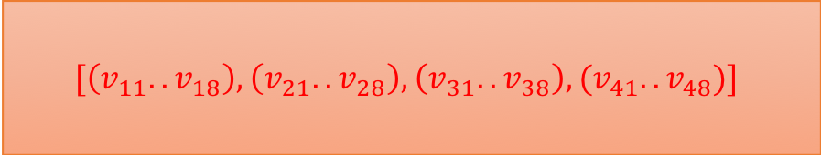
Working with sequence data: Embeddings and Word Vectors
[1,2,3,4]
[1,2,3,5]
[1,2,3,6]
$$[\left(v_{11}..v_{18}\right),\left(v_{21}..v_{28}\right),\left(v_{31}..v_{38}\right),(v_{41}..v_{48})]$$
Embedding Layer
word1
word2
word3
word4
word5
v1 | v2 | v3 | v4 | … | … | … | vn
v1 | v2 | v3 | v4 | … | … | … | vn
v1 | v2 | v3 | v4 | … | … | … | vn
v1 | v2 | v3 | v4 | … | … | … | vn
v1 | v2 | v3 | v4 | … | … | … | vn
N= 8

Slide 21
Working with sequence data: Embeddings and Word Vectors
Word 1 vector
[1,2,3,4]
[1,2,3,5]
[1,2,3,6]
$$[\left(v_{11}..v_{18}\right),\left(v_{21}..v_{28}\right),\left(v_{31}..v_{38}\right),(v_{41}..v_{48})]$$
Embedding Layer
word1
word2
word3
word4
word5
v1 | v2 | v3 | v4 | … | … | … | vn
v1 | v2 | v3 | v4 | … | … | … | vn
v1 | v2 | v3 | v4 | … | … | … | vn
v1 | v2 | v3 | v4 | … | … | … | vn
v1 | v2 | v3 | v4 | … | … | … | vn
N= 8

Slide 22
Working with sequence data: Embeddings and Word Vectors
After the training ends, the word vectors, obtained, end up preserving the context in the corpus
The way this happens is, words with similar context end up having similar vectors
Hence words with similar meanings and contexts, end up having vectors, that have very small cosine distance
King
(1,1,1,1)
Queen
(0.9,0.9,0.8,0.9)
Slave
(-1,-1,-1,-1)
(Cosine Distance) | king | queen | slave
king | 0 | 0.001 | 2
queen | 0.001 | 0 | 1.98
slave | 2 | 1.98 | 0

Slide 23
Working with sequence data: Embeddings and Word Vectors
When embedding layer is used, the word vectors are learnt simultaneously with a classification task
When the text corpus is large, then using word embedding is a good idea
In most scenarios, we end up not creating our own word embeddings, but end up using pre-trained word embeddings
Commonly used pre-trained word vectors are:
Glove word embeddings from Stanford University
Fast text word embeddings from Facebook Research
Word2Vec from Google Research
Creating your own word embeddings in a manner similar to Google or Facebook research is theoretically possible, but requires specialized hardware with GPUs
These are usually trained on GPU clusters over very large corpus such as Wikipedia dump

Slide 24
Working with sequence data: Embeddings and Word Vectors
Embedding Layer
Pre-trained word vectors

Slide 25
Working with sequence data: Embeddings and Word Vectors
Embedding Layer
Dense
Layer
Softmax
Layer
Data
Non Trainable
Trainable

Slide 26
Code Demo

Slide 27
Working with sequence data: Embeddings and Word Vectors
For the sake of completeness we will discuss how pre-trained word vectors are computed
As mentioned earlier, this process is computationally expensive and requires a workstation with GPU and lots of RAM
Pre-Trained Word Embeddings
Skip-gram
Continuous Bag of Words

Slide 28
Working with sequence data: Embeddings and Word Vectors
CBOW: Continuous Bag of Words
The cat ate rat
Embedding Layer
Dense
Layer
Softmax
Layer
word1
word2
word3
word4
word5
v1 | v2 | v3 | v4 | … | … | … | vn
v1 | v2 | v3 | v4 | … | … | … | vn
v1 | v2 | v3 | v4 | … | … | … | vn
v1 | v2 | v3 | v4 | … | … | … | vn
v1 | v2 | v3 | v4 | … | … | … | vn

Slide 29
Working with sequence data: Embeddings and Word Vectors
Input
Input
The cat ate rat
Embedding Layer
Dense
Layer
Softmax
Layer
word1
word2
word3
word4
word5
v1 | v2 | v3 | v4 | … | … | … | vn
v1 | v2 | v3 | v4 | … | … | … | vn
v1 | v2 | v3 | v4 | … | … | … | vn
v1 | v2 | v3 | v4 | … | … | … | vn
v1 | v2 | v3 | v4 | … | … | … | vn

Slide 30
Working with sequence data: Embeddings and Word Vectors
Input
Input
The dog barked at cat
Embedding Layer
Dense
Layer
Softmax
Layer
word1
word2
word3
word4
word5
v1 | v2 | v3 | v4 | … | … | … | vn
v1 | v2 | v3 | v4 | … | … | … | vn
v1 | v2 | v3 | v4 | … | … | … | vn
v1 | v2 | v3 | v4 | … | … | … | vn
v1 | v2 | v3 | v4 | … | … | … | vn

Slide 31
Working with sequence data: Embeddings and Word Vectors
Skipgram Model
The cat ate rat
Embedding Layer
Dense
Layer
Softmax
Layer
word1
word2
word3
word4
word5
v1 | v2 | v3 | v4 | … | … | … | vn
v1 | v2 | v3 | v4 | … | … | … | vn
v1 | v2 | v3 | v4 | … | … | … | vn
v1 | v2 | v3 | v4 | … | … | … | vn
v1 | v2 | v3 | v4 | … | … | … | vn

Slide 32
Working with sequence data: Embeddings and Word Vectors
Skipgram Model
Input
The cat ate rat
Embedding Layer
Dense
Layer
Softmax
Layer
word1
word2
word3
word4
word5
v1 | v2 | v3 | v4 | … | … | … | vn
v1 | v2 | v3 | v4 | … | … | … | vn
v1 | v2 | v3 | v4 | … | … | … | vn
v1 | v2 | v3 | v4 | … | … | … | vn
v1 | v2 | v3 | v4 | … | … | … | vn

Slide 33
Working with sequence data: Embeddings and Word Vectors
Skipgram Model
Input
The cat ate rat
Embedding Layer
Dense
Layer
Softmax
Layer
word1
word2
word3
word4
word5
v1 | v2 | v3 | v4 | … | … | … | vn
v1 | v2 | v3 | v4 | … | … | … | vn
v1 | v2 | v3 | v4 | … | … | … | vn
v1 | v2 | v3 | v4 | … | … | … | vn
v1 | v2 | v3 | v4 | … | … | … | vn

Slide 34
Working with sequence data: Embeddings and Word Vectors
Word 1
(34,0.82,69,72,81)
Word 2
(16,18,19,20,21)
Word N
(60,66,63,64,65)

Slide 35
RNNs and LSTMs

Slide 36
Recurrent Neural Networks:
So far we’ve looked at Embedding Layers
They help in providing contextual representation to words
But, embedding layers alone aren’t able to account for sequential nature of data
We need specialised neural network architectures, such as RNN, Recurrent Neural Networks

Slide 37
Recurrent Neural Networks: RNN
This is sentence one
[1,2,3,4]

Slide 38
Recurrent Neural Networks: RNN
This is sentence one
[1,2,3,4]
Embedding Layer
[(v1,v2),(v1,v2),(v1,v2),(v1,v2)]

Slide 39
Recurrent Neural Networks: RNN
This is sentence one
[1,2,3,4]
[(v1,v2),(v1,v2),(v1,v2),(v1,v2)]
Recurrent Layer
Softmax
Layer
Embedding Layer

Slide 40
Recurrent Neural Networks: RNN
This is sentence one
[1,2,3,4]
[(v1,v2),(v1,v2),(v1,v2),(v1,v2)]

Slide 41

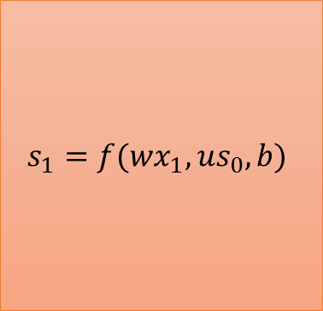

Recurrent Neural Networks: RNN
This is sentence one
[1,2,3,4]
[(v1,v2),(v1,v2),(v1,v2),(v1,v2)]
$$s_{1}=f(wx_{1},{us}_{0},b)$$
$x_{1}$= This
$$s_{i}=f({wx}_{i},{us}_{i−1},b)$$

Slide 42
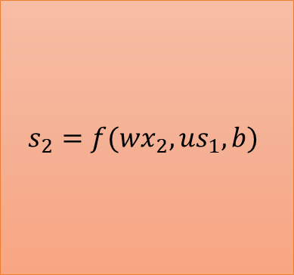


Recurrent Neural Networks: RNN
This is sentence one
[1,2,3,4]
[(v1,v2),(v1,v2),(v1,v2),(v1,v2)]
$$s_{1}=f(wx_{1},{us}_{0},b)$$
$$s_{2}=f(wx_{2},{us}_{1},b)$$
$x_{1}$= This
$x_{2}$= is
$$s_{i}=f({wx}_{i},{us}_{i−1},b)$$

Slide 43



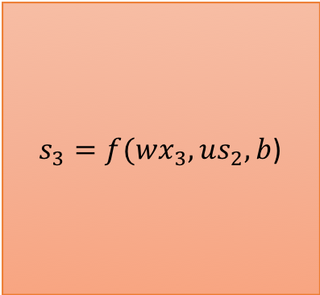
Recurrent Neural Networks: RNN
This is sentence one
[1,2,3,4]
[(v1,v2),(v1,v2),(v1,v2),(v1,v2)]
$$s_{1}=f(wx_{1},{us}_{0},b)$$
$$s_{2}=f(wx_{2},{us}_{1},b)$$
$s_{3}=f(wx_{3},{us}_{2},b$)
$x_{1}$= This
$x_{2}$= is
$x_{3}$= sentence
$$s_{i}=f({wx}_{i},{us}_{i−1},b)$$

Slide 44
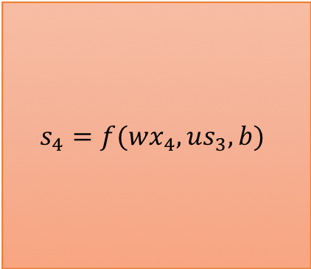

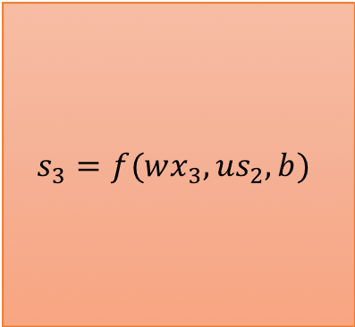
Recurrent Neural Networks: RNN
This is sentence one
[1,2,3,4]
[(v1,v2),(v1,v2),(v1,v2),(v1,v2)]
$$s_{1}=f(wx_{1},{us}_{0},b)$$
$$s_{2}=f(wx_{2},{us}_{1},b)$$
$$s_{3}=f(wx_{3},{us}_{2},b)$$
$$s_{4}=f(wx_{4},{us}_{3},b)$$
$x_{1}$= This
$x_{2}$= is
$x_{3}$= sentence
$x_{4}$= one
$$s_{i}=f({wx}_{i},{us}_{i−1},b)$$

Slide 45

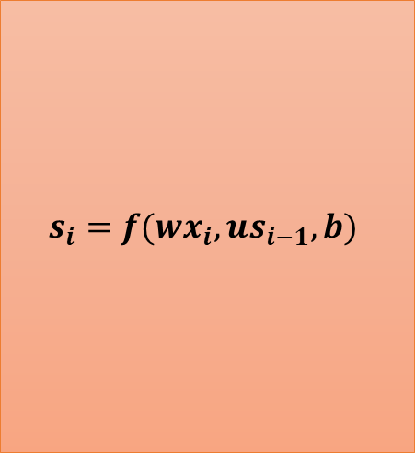

Recurrent Neural Networks: RNN
$$s_{i}$$
$$s_{i}=f({wx}_{i},{us}_{i−1},b)$$
$$x_{i}$$

Slide 46
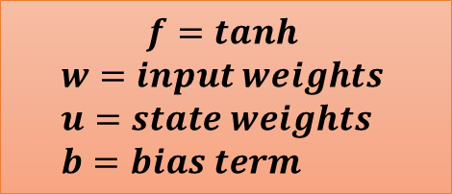
Recurrent Neural Networks: RNN
$$s_{i}$$
$$f=tanh$$
$$w=input weights \\ u=state weights \\ b=bias term$$
$$s_{i}=f({wx}_{i},{us}_{i−1},b)$$
$$x_{i}$$

Slide 47
Recurrent Neural Networks: RNN
$$s_{i}$$
$$f=tanh$$
$$w=input weights \\ u=state weights \\ b=bias term$$
$$s_{i}=f({wx}_{i},{us}_{i−1},b)$$
Shape of W=(cols of word vec, cols of word vec)
Shape of U=(cols of word vec, cols of word vec)
Shape of b=(cols of word vec,)
$$x_{i}$$

Slide 48
LSTM

Slide 49
Long Short Term Memory: LSTM
So far we’ve looked at how RNNs are able to account for sequential nature of data
One limitation of using RNNs is that they are not able to keep memory of very long sequences
This issue is solved by LSTMs, LSTMs are a special type of RNN, that are able to keep memory of long sequences
In general you will find yourself using LSTMs more often than plain RNNs

Slide 50
Long Short Term Memory: LSTM
This is sentence one
[1,2,3,4]

Slide 51
Long Short Term Memory: LSTM
This is sentence one
[1,2,3,4]
Embedding Layer
[(v1,v2),(v1,v2),(v1,v2),(v1,v2)]

Slide 52
Long Short Term Memory: LSTM
This is sentence one
[1,2,3,4]
[(v1,v2),(v1,v2),(v1,v2),(v1,v2)]
LSTM Layer
Softmax
Layer
Embedding Layer

Slide 53
Long Short Term Memory: LSTM
This is sentence one
[1,2,3,4]
[(v1,v2),(v1,v2),(v1,v2),(v1,v2)]

Slide 54



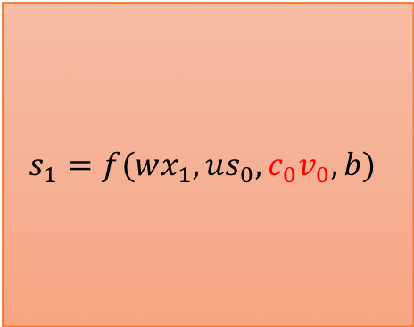



Long Short Term Memory: LSTM
This is sentence one
[1,2,3,4]
[(v1,v2),(v1,v2),(v1,v2),(v1,v2)]
$$s_{1}=f(wx_{1},{us}_{0},c_{0}v_{0},b)$$
$$s_{t}=f({wx}_{t},{us}_{t−1},c_{t−1}v_{0}, b)$$
$$i_{t}=f({w_{i}x}_{t},{u_{i}s}_{t−1}, b_{i})$$
Input Gate
$$f_{t}=f({w_{f}x}_{t},{u_{f}s}_{t−1}, b_{f})$$
Forget Gate
$$O_{t}=f({w_{O}x}_{t},{u_{O}s}_{t−1}, b_{O})$$
Output Gate
$$C_{t}=i_{t−1 }×O_{t−1}+C_{t−1}∗f_{t−1}$$
Carry State
$x_{1}$= This

Slide 55


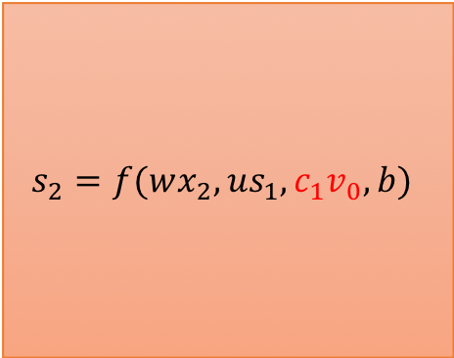
Long Short Term Memory: LSTM
This is sentence one
[1,2,3,4]
[(v1,v2),(v1,v2),(v1,v2),(v1,v2)]
$$s_{1}=f(wx_{1},{us}_{0},c_{0}v_{0},b)$$
$$s_{2}=f(wx_{2},{us}_{1},c_{1}v_{0},b)$$
$x_{1}$= This
$x_{2}$= is
$$s_{t}=f({wx}_{t},{us}_{t−1},c_{t−1}v_{0}, b)$$

Slide 56

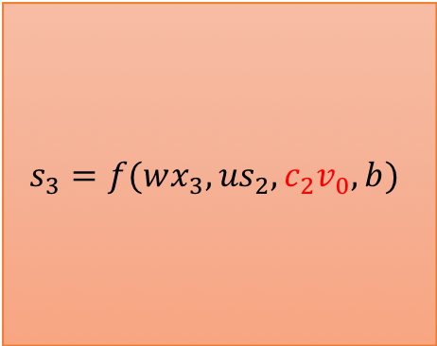
Long Short Term Memory: LSTM
This is sentence one
[1,2,3,4]
[(v1,v2),(v1,v2),(v1,v2),(v1,v2)]
$$s_{1}=f(wx_{1},{us}_{0},c_{0}v_{0},b)$$
$$s_{2}=f(wx_{2},{us}_{1},c_{1}v_{0},b)$$
$$s_{3}=f(wx_{3},{us}_{2},c_{2}v_{0},b)$$
$x_{1}$= This
$x_{2}$= is
$x_{3}$= sentence
$$s_{t}=f({wx}_{t},{us}_{t−1},c_{t−1}v_{0}, b)$$

Slide 57



Long Short Term Memory: LSTM
$$s_{i}$$
$$s_{t}=f({wx}_{t},{us}_{t−1},c_{t−1}v_{0}, b)$$
$$x_{i}$$

Slide 58


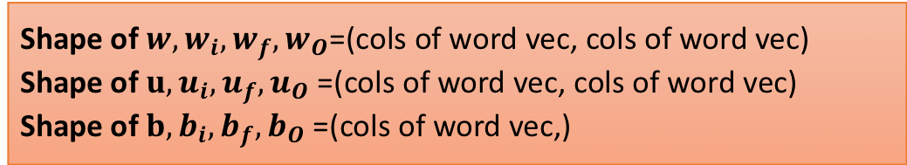
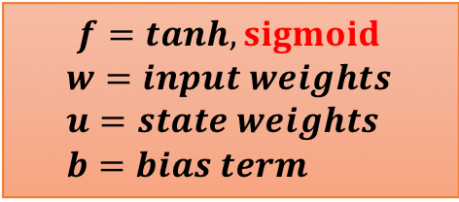

Long Short Term Memory: LSTM
$$s_{i}$$
$$f=tanh,sigmoid$$
$$w=input weights \\ u=state weights \\ b=bias term$$
$$s_{t}=f({wx}_{t},{us}_{t−1},c_{t−1}v_{0}, b)$$
Shape of $w,w_{i},w_{f},w_{O}$=(cols of word vec, cols of word vec)
Shape of $u,u_{i},u_{f},u_{O}$=(cols of word vec, cols of word vec)
Shape of $b,b_{i},b_{f},b_{O}$=(cols of word vec,)
$$i_{t}=f({w_{i}x}_{t},{u_{i}s}_{t−1}, b_{i})$$
$$f_{t}=f({w_{f}x}_{t},{u_{f}s}_{t−1}, b_{f})$$
$$O_{t}=f({w_{O}x}_{t},{u_{O}s}_{t−1}, b_{O})$$
$$x_{i}$$

